Slide 1
BLIP-2
정승민 ( 2025.06.13)

Slide 2
Contents
Abstract & Introduction
Model Architecture
Bootstrap Vision-Language Representation Learning rom a Frozen Image Encoder
Bootstrap Vision-to-Language Generative Learning form a Frozen LLM
Experiment
Conclusion

Slide 3
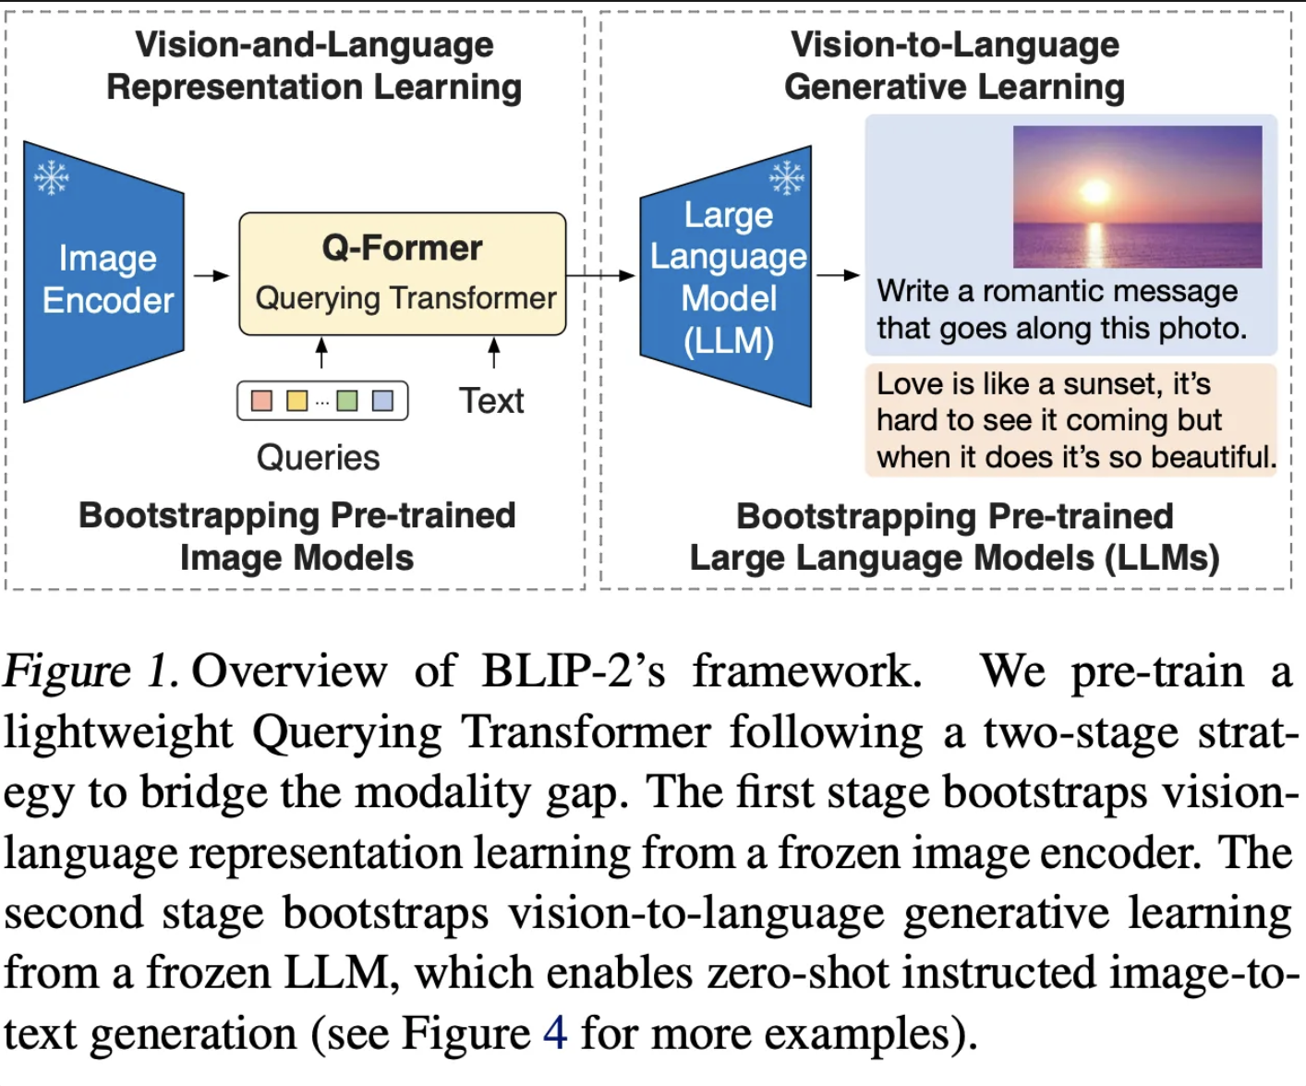
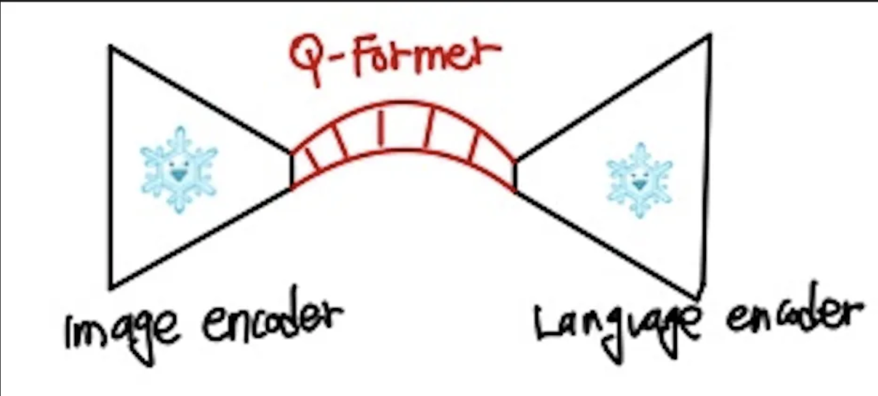
Abstract & Introduction
[ Q-Former serves as a bridge between two different modality ]

Slide 4
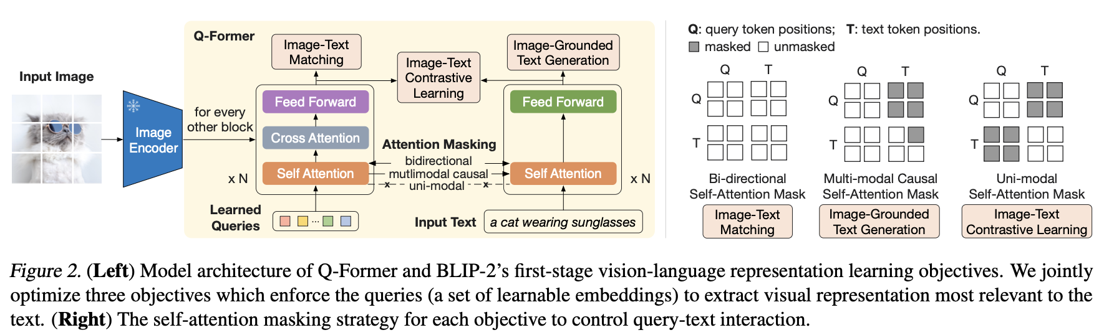
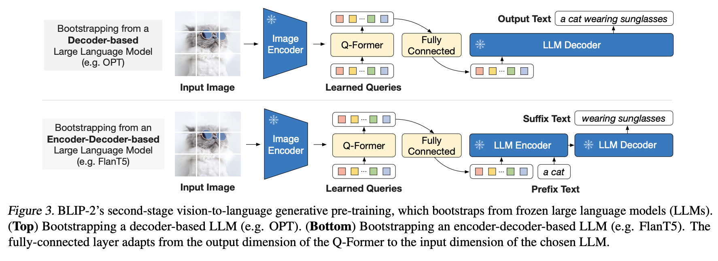
Model Architecture
Stage1 : Image-Language Representation Learning
Stage2 : Image-to-Language Generative Learning

Slide 5
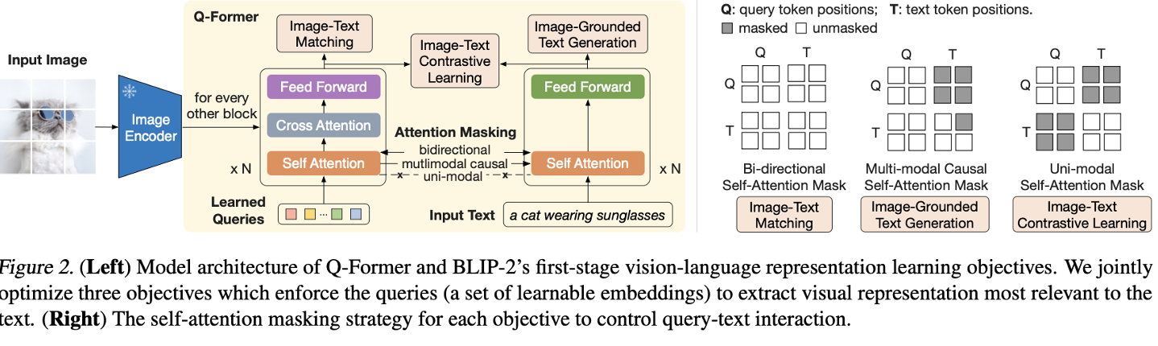
Bootstrap Vision-Language Representation Learning rom a Frozen Image Encoder
Inspired by BLIP, BLIP-2 have 3 task. This task aim for to train the Q-Former such that the
Queries can learn to extract visual representation that is most informative of the text.
ITC
ITG
ITM

Slide 6
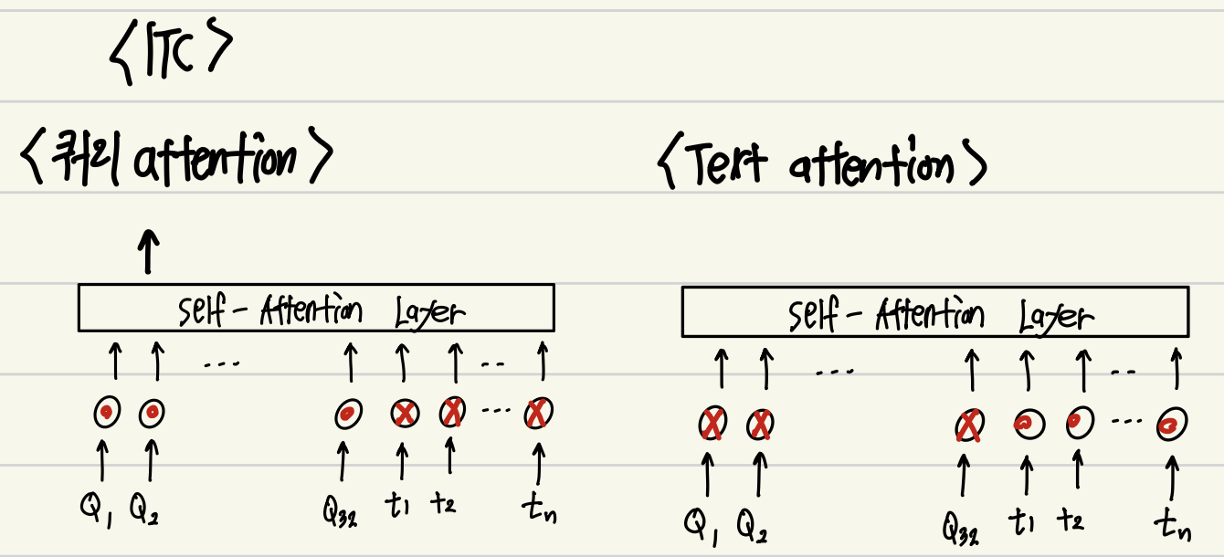
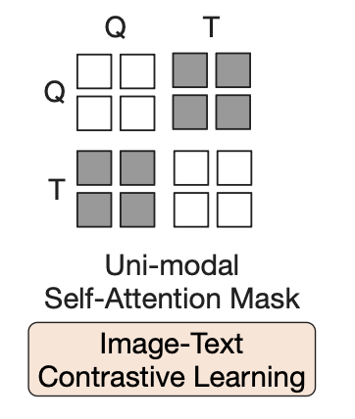
ITC ( Image-Text Contrastive Learning )
Notes:
[CLS]와 가장 연관성이 높은 Z만 활요해서 Negaitve 인지 Positive인지 판별한다.

Slide 7
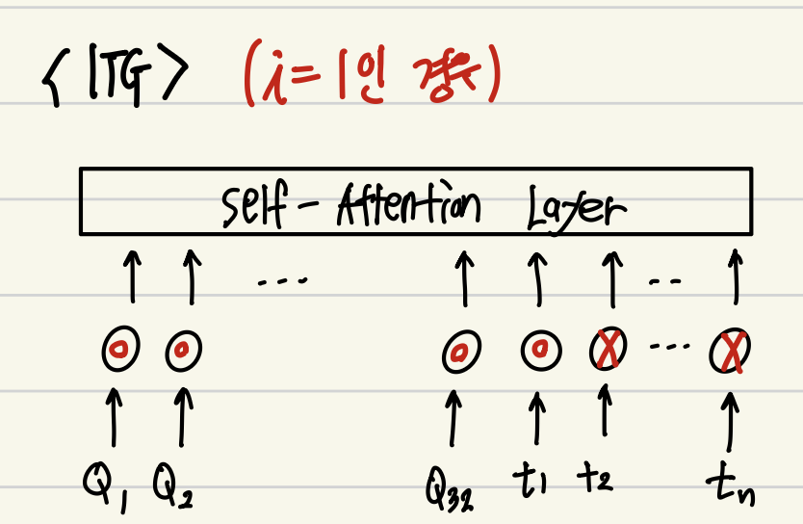
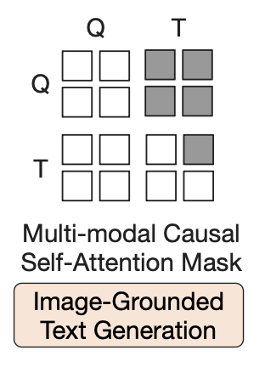
ITG : Image-grounded Text Generation

Slide 8
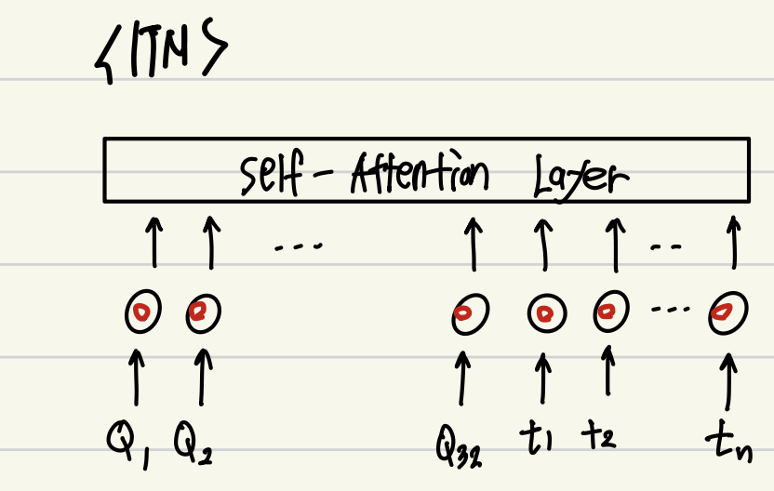
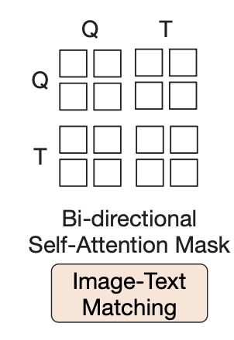
ITM : Image-Text matching
Notes:
매칭 시에는 Z들과 text 의 [CLS] 와의 평균을 최종 점수로 활용한다.

Slide 9

Bootstrap Vision-to-Language Generative Learning form a Frozen LLM
In the generative pr-training stage, Q-Former learn generative capability using Z ( image soft prompt )
Using 2 task
Decoder Based LLM : input = Only use z ( Image prompt )
Encoder-Decoder Based LLM : input = Image prompt + prefix

Slide 10
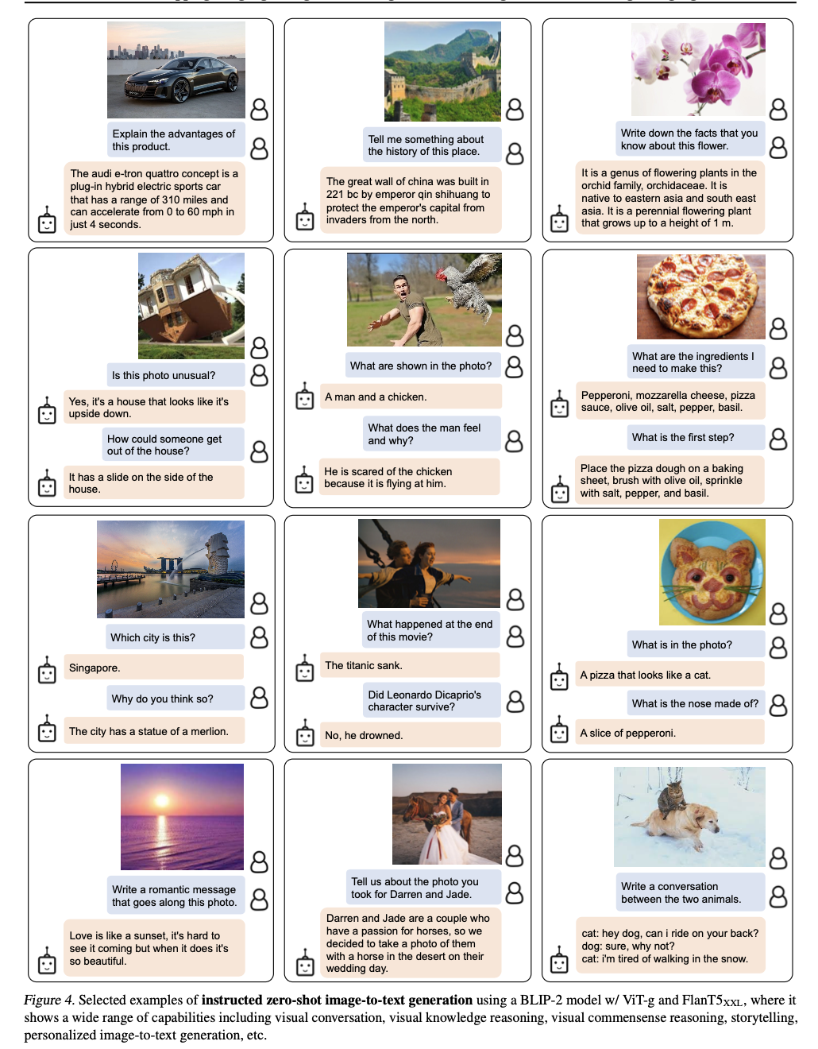
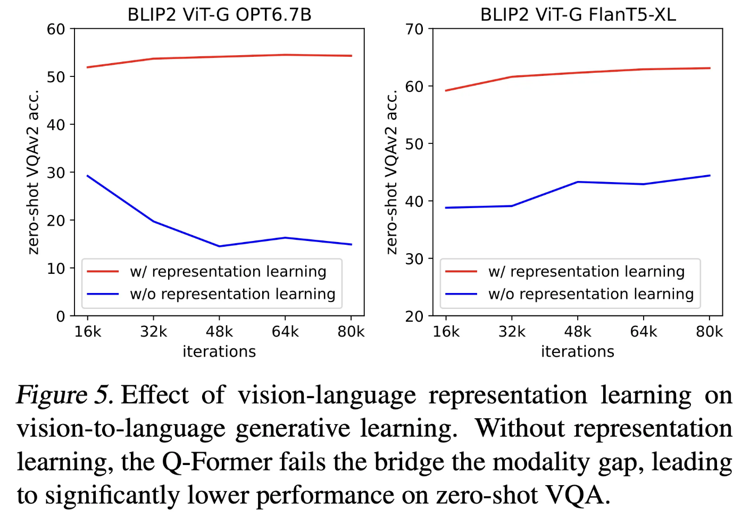
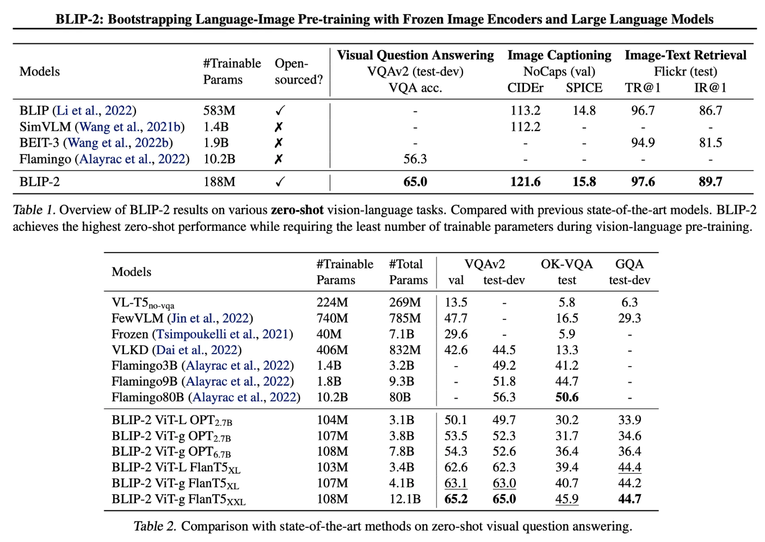
Experiments

Slide 11
Conclusion
BLIP-2 proposes a model that leverages a frozen image encoder and an LLM, employing a parameter‐efficient Q-Former to bridge the modality gap between images and text.
Despite its small parameter footprint, this model delivers strong zero-shot performance and represents a significant milestone in the evolution of AI agents.

